Slide 1

healthcare financial Analytics report
& Dashboard

Slide 2
GROUP-1
Project team members
1. Mr. Rajesh Kumar Mahato
2. Mr. Sanjay
3. Ms. Sandhya Rajan Birje
4. Mr. Akshay Sanjay Warang
5. Mr. Srikanth
6. Mr. Shubham Biswas
7. Mr. Neelisetty Venkata Sai Varun
Project mentor:
1. Mr. Mahendra

Slide 3
Summary of project
Purpose:
Migration of Hospital quarterly Financial and Utilization data Report of State Of California Office Of Statewide Health Planning and Development from Excel(spreadsheet) to BI Tools such as Power BI and Tableau.
Analytics & Dashboard for Stake-Holders .
Data overview:
Data used as a documentation for Hospital Quarterly Financial and utilization data file.
Data item includes Patient days, Outpatient visits, Outpatient revenue , Inpatient revenue , Deduction from revenue, Capitation. premium revenue , Net patient revenue , Expense Data , Total capital expenditure.
Methods used :
Understanding the data and identifying the trend and pattern to start analysis on top of available data.
Data Merging from year 2016 to 2020 Hospital quarterly financial table.
Creation of wireframe and Dashboard in Excel.
Data import to Tableau and Dashboard.
Data import to SQL Server and creation of KPI or report table using aggregate and window function .
Import of KPI to Power BI and Creation of Dashboard.
Dashboard with key performance indicator:
Total Discharge
Patient Days
Net Patient Revenue
Revenue Trend
Patient Stays
State Wise No of hospital /Revenue
Type Of hospital Revenue
Total Patient, Total Doctor, Total Hospital

Slide 4

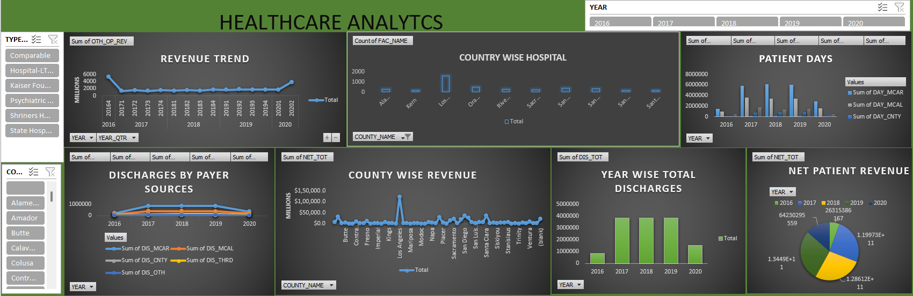
Excel dashboard of healthcare analytics report

Slide 5

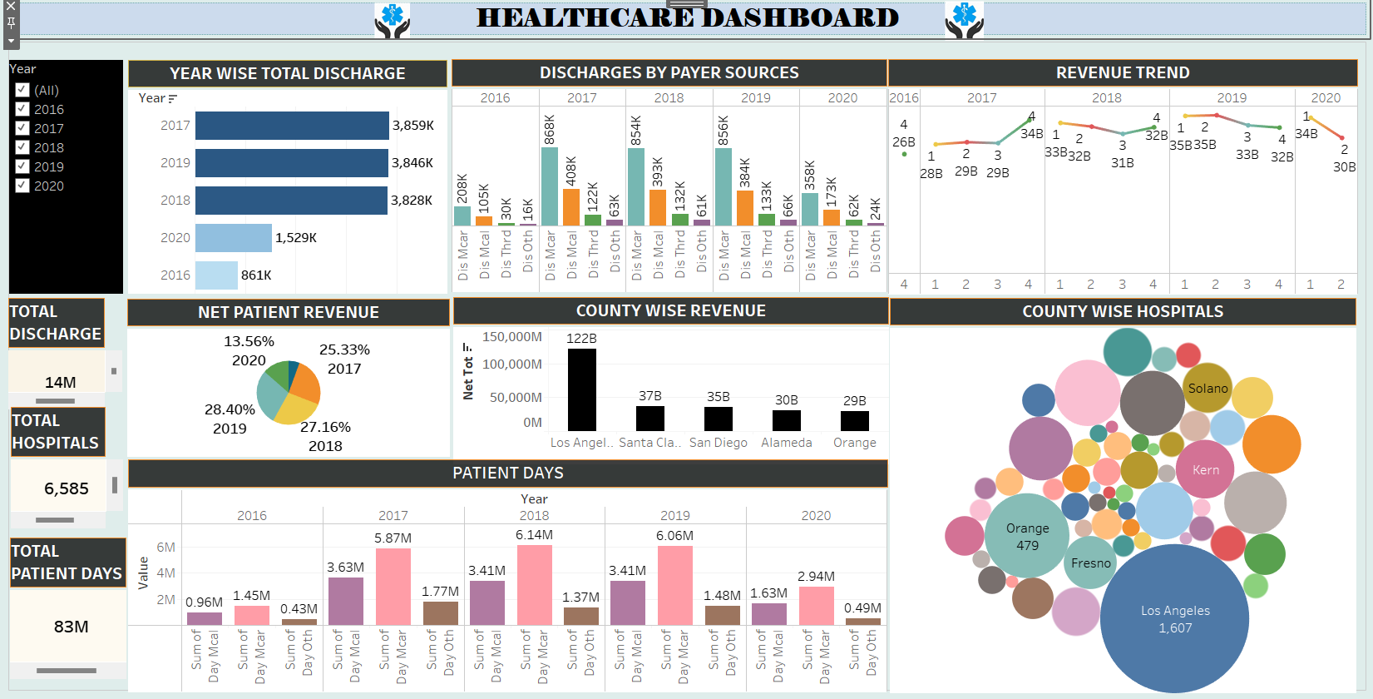
tableau dashboard of healthcare analytics report

Slide 6

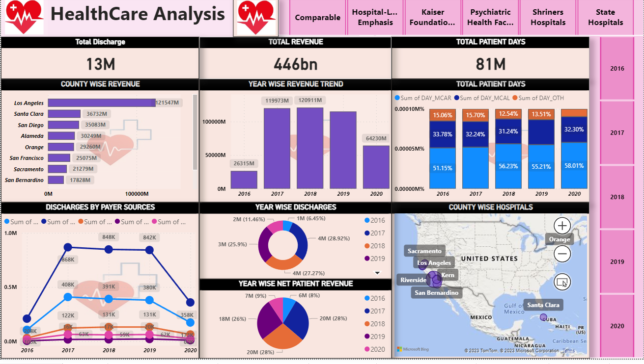
power-bi dashboard of healthcare analytics report

Slide 7
Final key points
Sum of NET_TOT trended up, resulting in a 144.08% increase between 2016 and 2020.
Los Angeles has the highest Sum of NET_TOT as 12154 million and was 1,074.30% higher than Fresno, which had the lowest Sum of NET_TOT at 10350 million.
﻿Los Angeles alone accounted for 35.53% of Sum of Net total.
Across all COUNTY, revenue as NET_TOT ranged from 10350 million to 12154 million.
Gross inpatient revenue accounted for 60.96% which is higher than about 20% of gross outpatient revenue for 39.04%.
Revenue from the inpatient care outperformed the revenue generated from outpatient care year over year from 2016 to 2020.
Los Angeles has the highest bad debt as 3043 million.
Santa Clara generated significant revenue for the California state despite of lesser number of hospital.
Most of the revenue generating county has higher bad debt.
High total operating expense observed as 514 billion.
Most of the discharge done through medical-Traditional payer source.

Slide 8
Thank you

